Slide 1

Ruth Villanueva, Mike Bui, Kelvin Le, Davis Tran, Soledad Ordunez

Slide 2
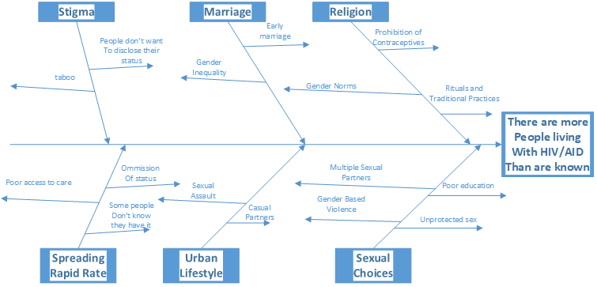
Ishikawa Diagram
Notes:
The ishikawa diagram illustrates the various causes of our main issue that we want our app to solve. Basically we are interested on the issue of HIV/AID and want to find ways to help diagnose those with HIV/AIDS or to help provide support for those who already know that they have HIV/AID or have loved ones that have HIV/AID. One of the main causes is stigma since people do not want to disclose their status since they fear that they will be ostracized by others. Marriage is a factor since those who get married early are more at risk of contracting HIV/AID. Religion is another main cause since many religions such as Catholicism prohibited the use of contraceptives which can increase the risk of contracting HIV/AID or other STDs. Another main factor is the spreading rapid rate of HIV/AID which can be attributed to a large portion of the population having poor access to healthcare or have limited knowledge about HIV/AID. HIV/AID is also more common in urban areas due to the high concentration of people and higher levels of sexual assault. A person’s own sexual choices is another big reason as they may do risky sexual activities such as having multiple partners or unprotected sex which increase their chances of contracting HIV/AID

Slide 3
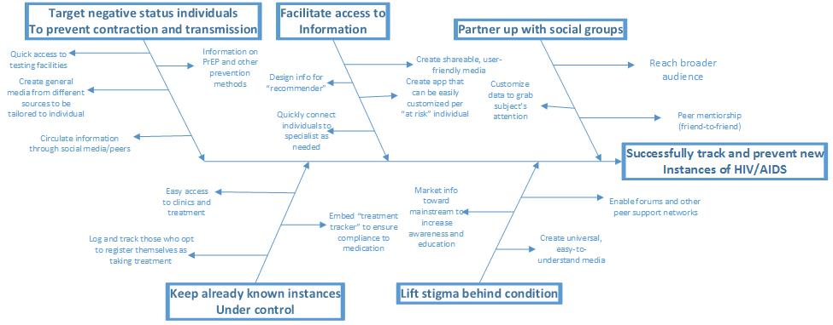
Reverse Ishikawa Diagram

Slide 4
Business Motivation Model - Part One
Means
Assessment
End
Mission: Provide a medium designed to reduce the spread of HIV and AIDS through a variety of services such as education, support, and guidance.
Strategy: To deliver a place of confidentiality and trust by providing anonymity, options of communication, and choices with no obligations.
Tactic: Work with treatment facilities and survivors to gain insight on the needs, symptoms and other information & develop an app that provides guidance and support to individuals affected by HIV/AIDS or who would like to educate themselves.
Weakness: Barriers to reach potential users and gain their trust; user friendliness
Strength: Variety of communication options, influential sources
Potential Impact: Provide a safe place, and reach many in a way they will feel comfortable with.
Vision: To develop an accessible, user-friendly application that will reduce the spread of HIV/AIDS and help those living with it better manage the condition.
Goal: Educate and connect the masses with treatment facilities, for either themselves, or someone they are concerned for.
Objective: By the end of this class, have the platform be used by at least a few different potential users.
Influencer
Age of Users
Location of Treatment Facilities
Willingness/Comfortability with the topic
Exposure to topic
Notes:
The overall BMM is to explain our goal of getting users educate about AIDs and how to treat it and give them options of what to do if the person has the disease. Then with our assessment of the project is the market that this app markets to by determining the weaknesses, strength and impact of the project. The Means end is to establish why we are doing this project for people with the AIDs virus and how our project can possibly help them and how we are going to execute the plan. Also that the plan is to launch this app worldwide so everyone can have access to it and learn more about AIDs and be more informed about it than what they really know.

Slide 5
Business Motivation Model - Part Two
Referenced Elements
Business Motivation Model
Organization Unit: CIS 315 Group in support of Activist Groups
Business Process: Be active in knowing about about organization/groups/activists/ etc .
Business Rule: All services should be free and be accessible by all potential users.
Vocabulary
TBD
Notes:
This is just the second part to the BMM on the previous slide in which we explained the referenced elements of who is involved making it, and the business end of the model where we explain simple rules and process of what the app should have. At the moment we are still in the planning stages and don't have any vocabulary to fill in yet.

Slide 6
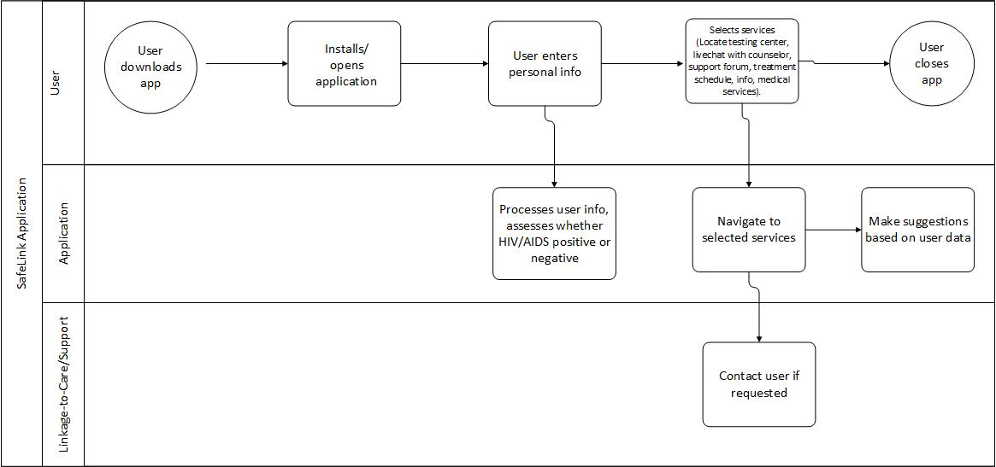
Business Process Model and Notation
Notes:
The Business Process Model and Notation (BPMN) specifies the various processes of our Business Motivation Model (BMM). For our BPMN, we display how our SafeLink app would work to help achieve our vision, goal, and objective as stated in our BMM. The app basically relies on the user downloading and installing it and entering their personal information into the app. Then the app would process their info to give out information about their HIV/AIDS status and send out multiple resources to either help them or someone else they know who are dealing with the issues of HIV/AIDS.

Slide 7
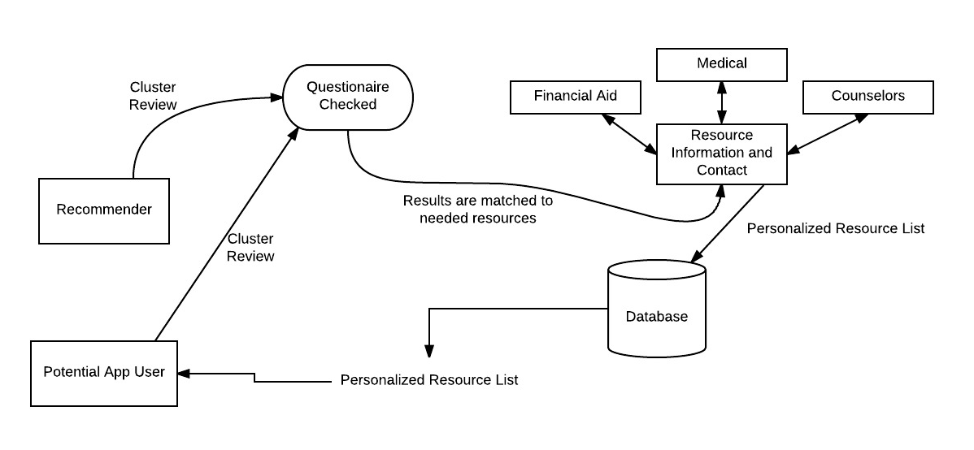
Data Flow Diagram
Notes:
Both a recommender and a potential App User can take a quick questionnaire that will then be reviewed by clustering answers that could pin point a possible issue. The questionnaire is then checked and the results are matched to the appropriate resource information and contact ( either financial aid, medical or counseling services. The information is personalized into a list that are then saved into the database with the users information that can be turned into a profile. This information is then sent to the potential app user.

Slide 8
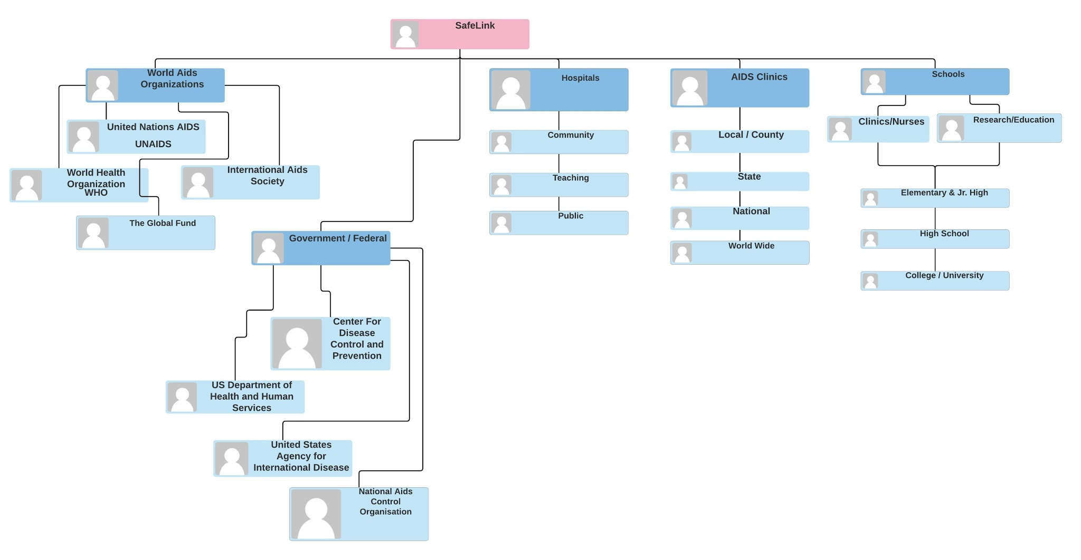
Organizational Chart
Notes:
With this organization chart it shows the hierarchy of the Safelink application. It starts with the president of the company in where starts within the company where it is considered onsite along with the different divisions of the company from marketing, finance and administration as part of the onsite section of the chart. For the offsite part of the chart it is to show the external entities that play a role to creating the app and the resources to populate the app. With the different divisions, it sets up the foreground for the app to start its production and for it to have resources from out of the company. For the app to work the organizational chart show who will be involved in the process of creating SafeLink from its contributors.

Slide 9
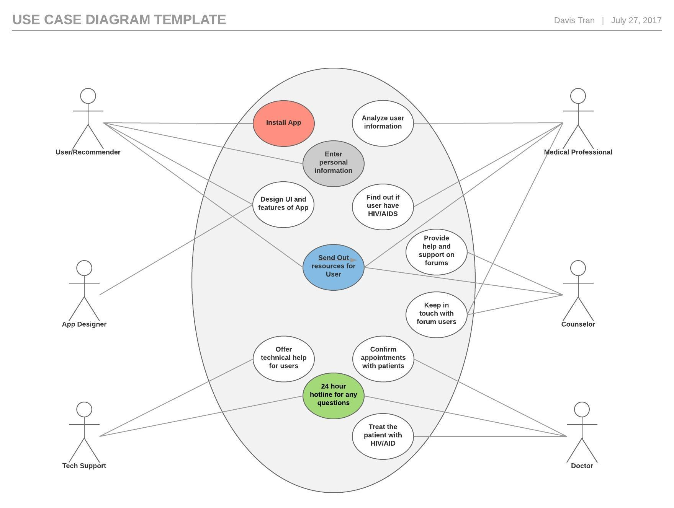
Use Case Diagram
Notes:
This use case diagrams shows the basic processes of the Safelink application and the various people that are involved with the application and the different kinds of actions they can perform. The User has the ability to Install the App, enter their personal info, and have access to the design UI and features of the App. Medical professionals and Counselors are shown having the ability to analyze user input regarding their symptoms and diagnosis and can provide a guideline on how to proceed with support or treatment. The App Design and Tech Support people are the structure needed to keep the app running without issues and bugs without them the app would be rendered useless.

Slide 10
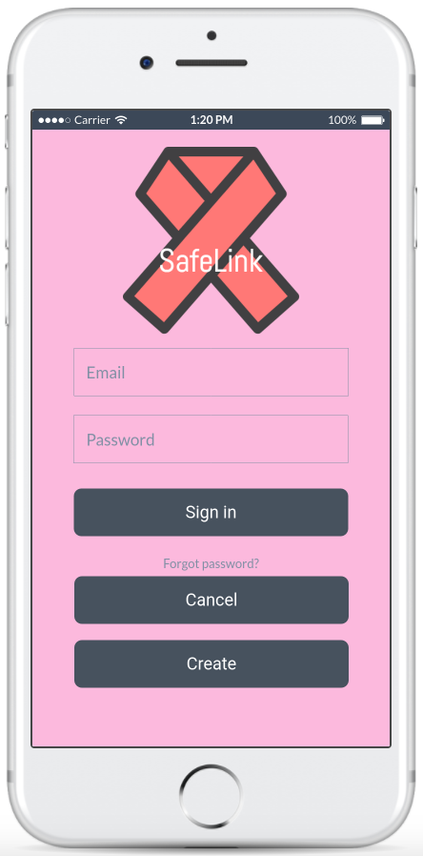
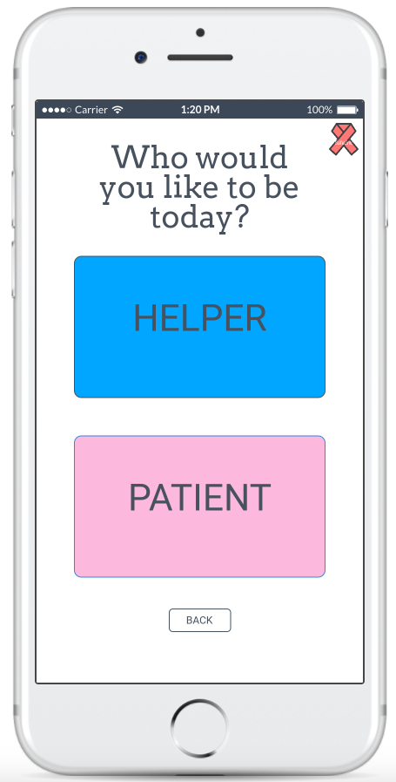
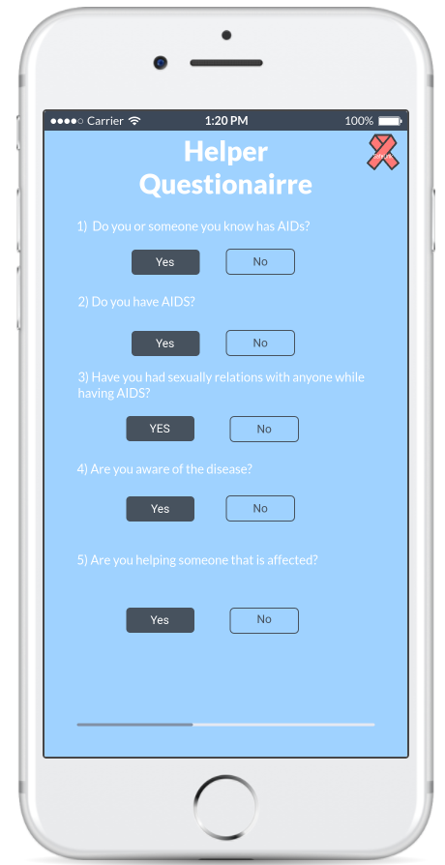
UI Design - Account Creation
Notes:
For our wireframe we used the website Marvel App where it allows us to build our app in a more simplistic approach where we are able to create the app on either a website, Android, or IOS platform. For the slide, if you click on to the iphone, it leads to our wireframe where it allows you to see how the app works and what is used in the wireframe for SafeLink.

Slide 11
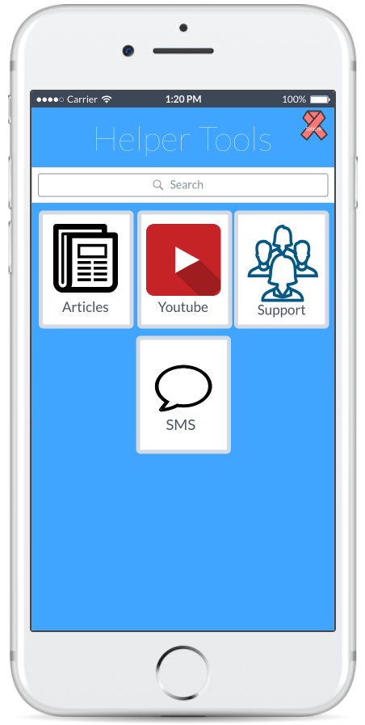
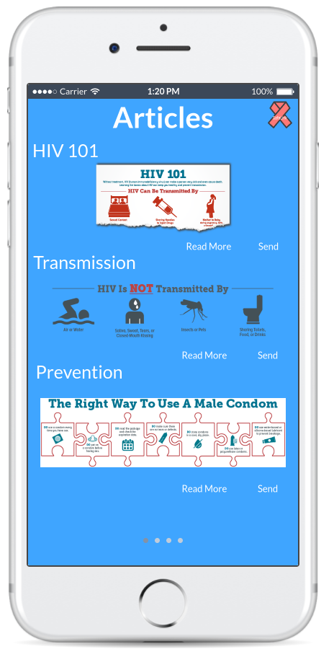
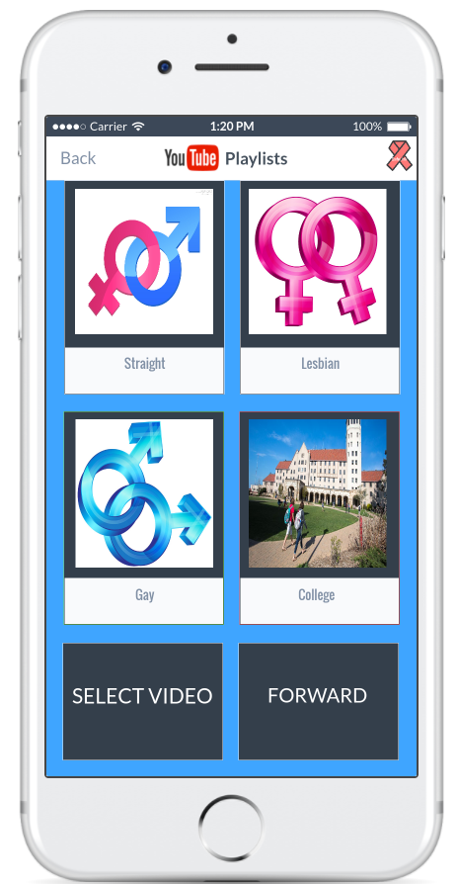
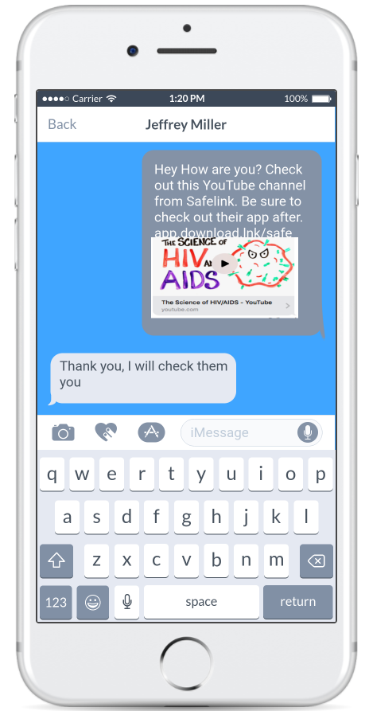
UI Design - Helper Tools

Slide 12
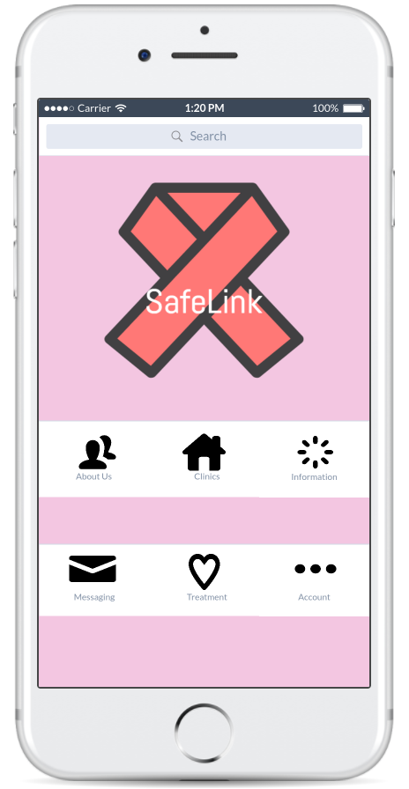
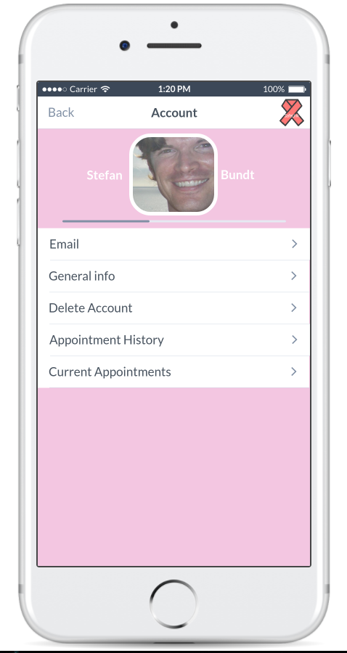
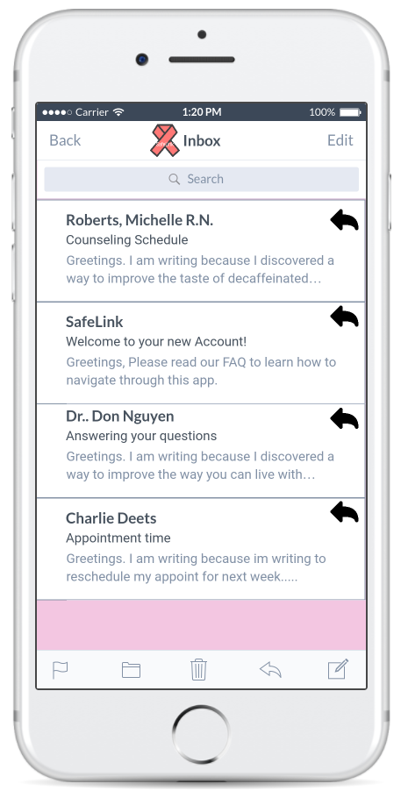
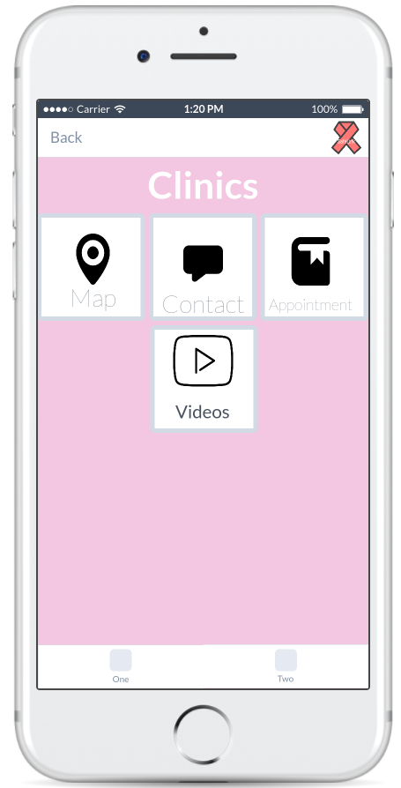
UI Design - Patient Side

Slide 13
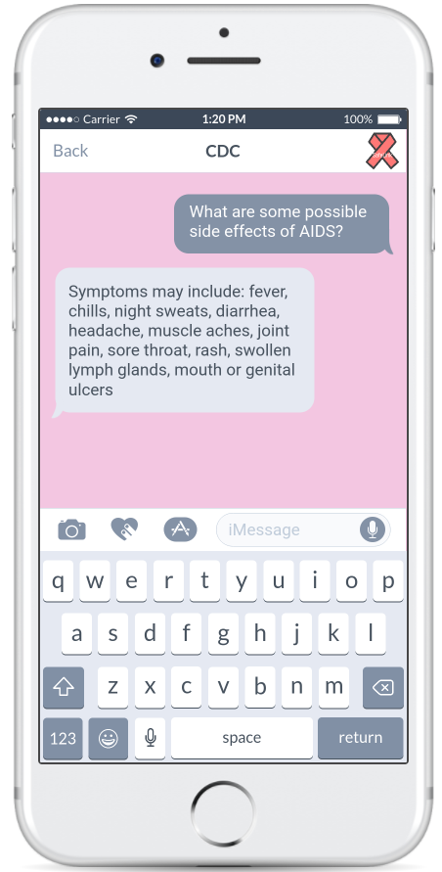
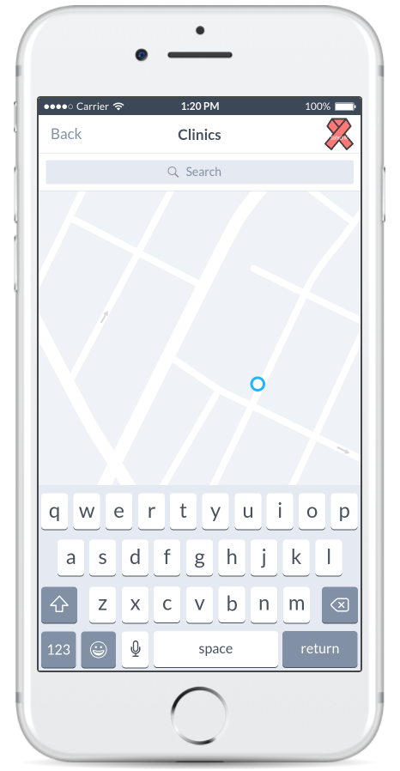
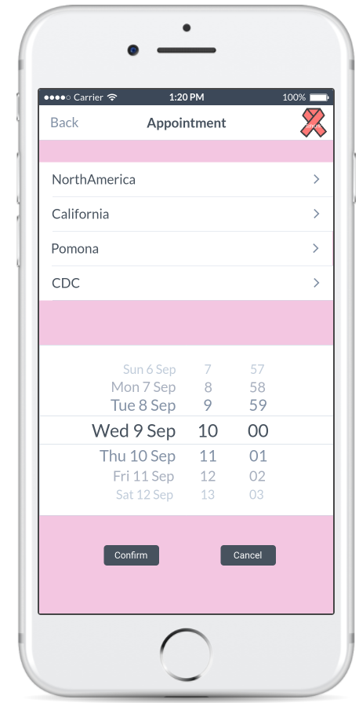
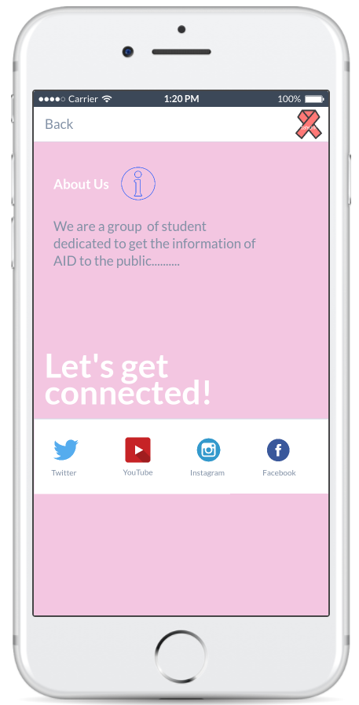
UI Design - Patient Side

Slide 14
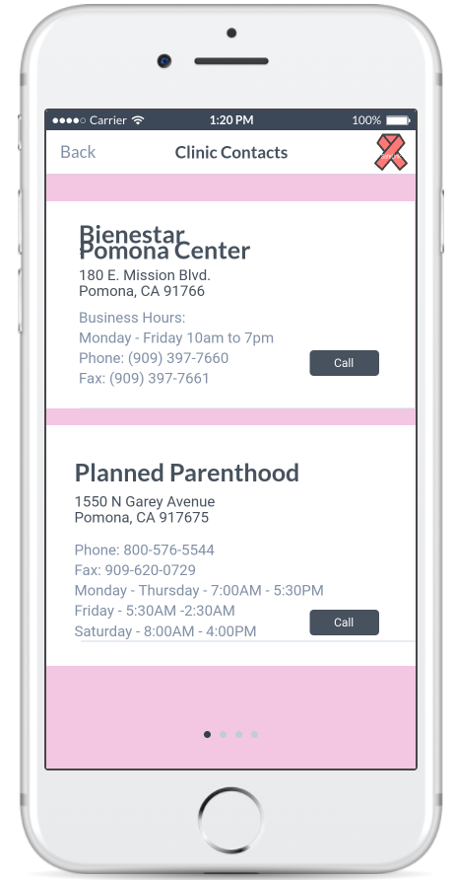
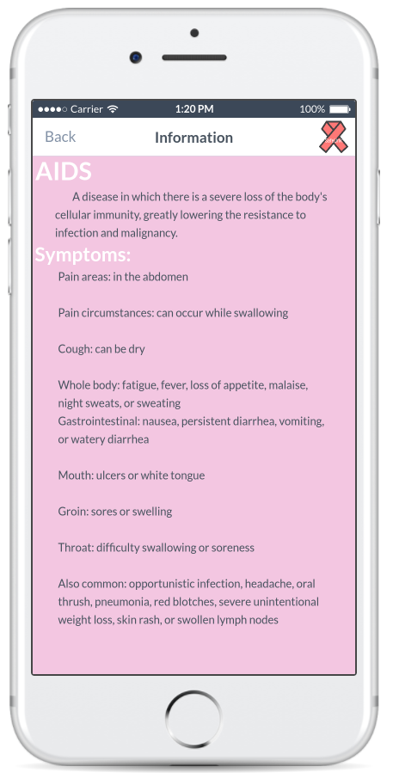
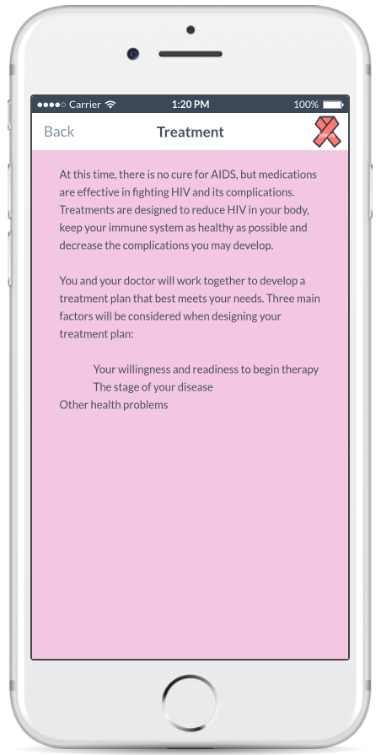
UI Design - Patient Side

Slide 15
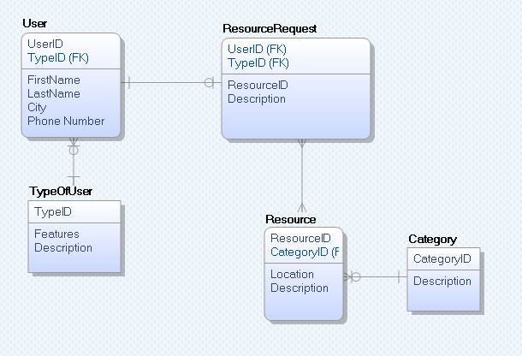
Entity-Relationship Diagram
Notes:
The ERD presents the information that is transferred in between the “entities”. The user contains its attributes and include a userID which will help track the other entities. A use can be a type of user, either the concerned recommender, or the possible patient. The attributes for the TypeOfUser include TypeID, the features (which are the features that are supposed to be available to the type of user, and a description as to what the type of user is suppose to be. The userID is used to connect to the ResourceRequest entity, which is the type of resource that the user is requesting (either for themselves or the person they are concerned about), and a description. The TypeID is also included to format the way the resource is handled and given. The resource contains a ResourceID and a CategoryID, the location and a description of the resource. Each resource would belong into a category (financial, medical, or counseling). A user can have many resource requests, but each resource request is unique to one user. The ResourceRequest can have many resources, and the resource can have many requests. The resource can only belong in one category, but the category can have many resources.

Slide 16
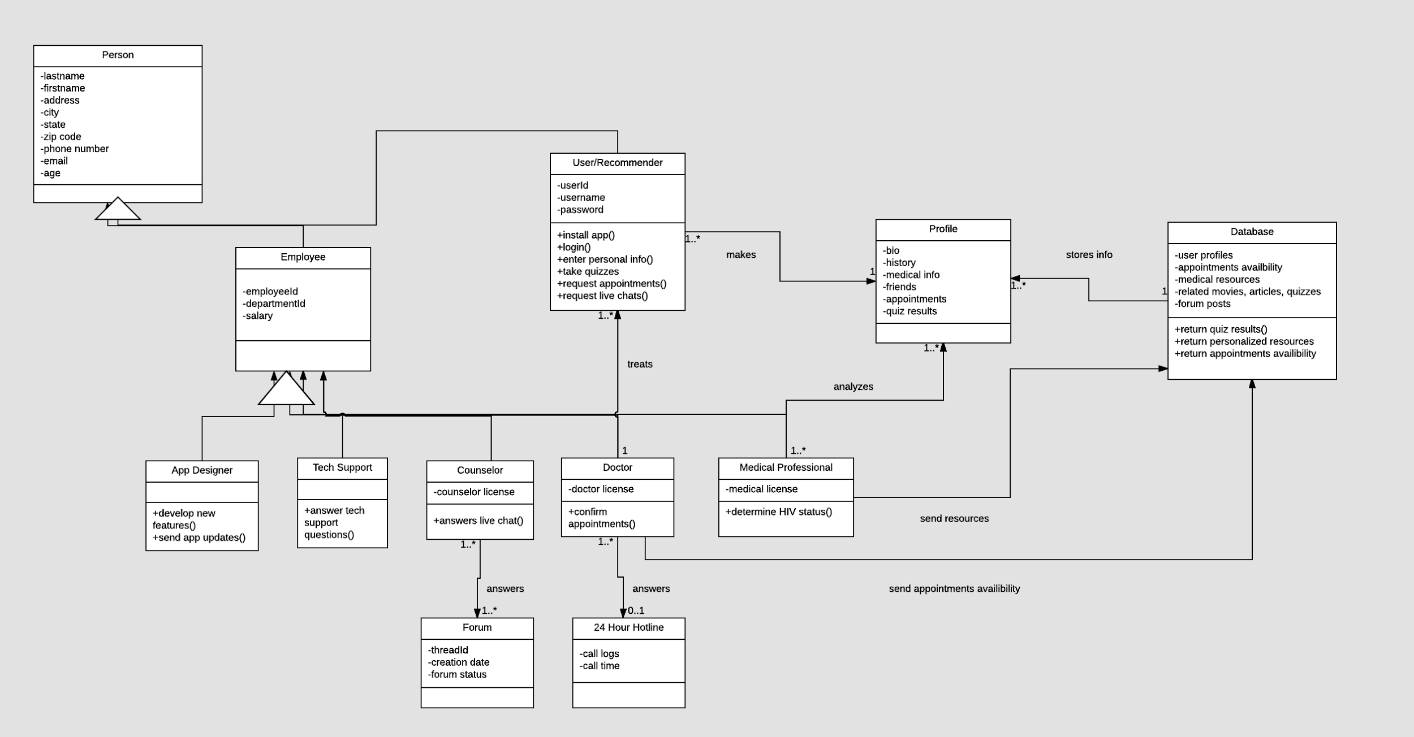
Class Diagram
Notes:
The class diagram shows various classes and their relationships among other classes in our system. It is very similar to the ERD diagram except it shows the use case diagram in a format that consists of classes, attributes, and operations. Classes represent a kind of person, place, or thing that the system must store information in. From the use case diagram, we have various actors such as user/recommender, app designer, tech support, counselor, doctor, and medical professional. For the class diagram, we portrayed each of those actors with classes which is shown with the rectangles. Additional classes such as Profile, Forum, 24 Hour Hotline, and Database are created from analyzing the use case diagram and sequence diagram and seeing which classes were needed. Each classes contains attributes which represent properties that are unique to each classes. For example, an employee class contains the attributes employeeId and salary which is unique to the employee class and are not attributes for other classes. The attributes are shown in the upper half of the classes. Classes also contain operations which show functions that a class can perform. For example, the doctor has the method of confirming appointments and the app designer has the method of sending app updates. Those methods are unique for each class and are not available in other classes. The operations are shown on the bottom half of the classes. The purpose of the class diagram is to show the associations between the classes. For example, there is an association between the user class and the profile class as the user can make a profile.The associations are represented by lines connecting each class to another class. Each associations are represented by multiplicity which show how many times a class can be associated with another class. For instance, one doctor can treat multiple users but a user can only be treated by one doctor. Class diagrams also includes generalization which means that a class can inherit from another class called the superclass. In our diagram, Person is a superclass for employee and user/recommender while employee is a superclass for app designer, tech support, counselor, doctor, and medical professional. Basically this means that employee and user/recommender are people and thus would inherit all the attributes from the Person class.Also there are different kinds of employees that would inherit all the attribute from the employee classes but would also have their own unique attributes specific to their jobs.

Slide 17
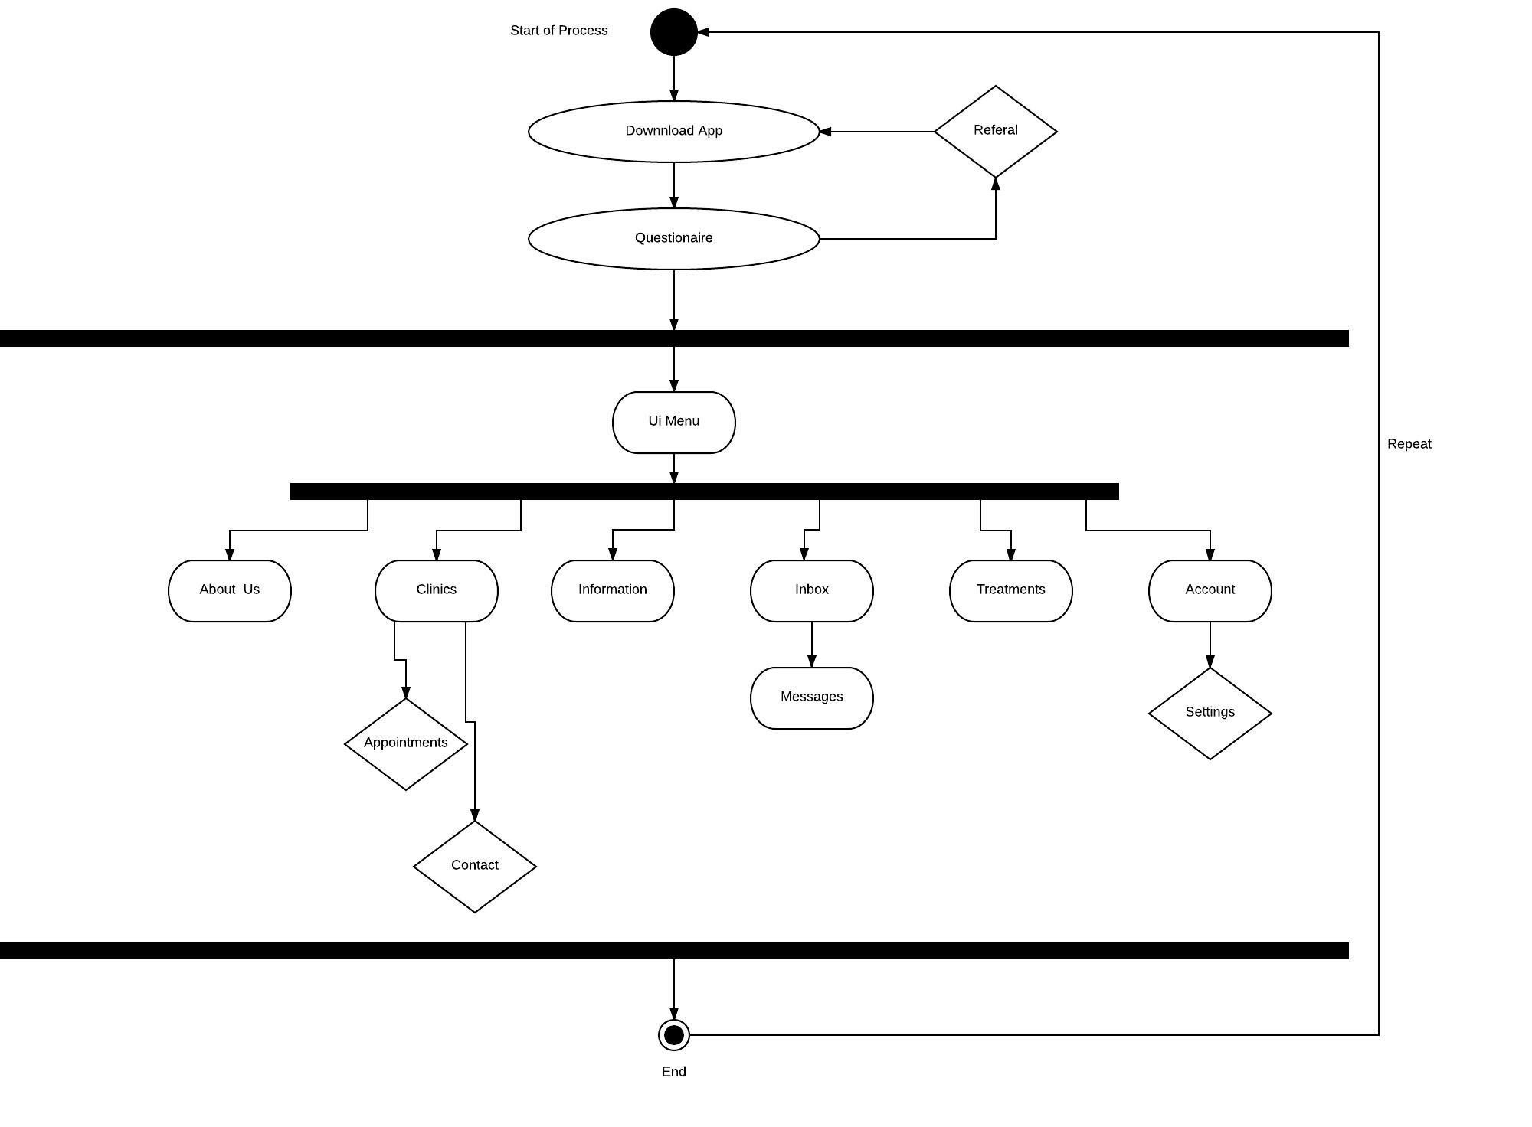
Activity Diagram
Notes:
For the Activity Diagram it just clearly show what happens when a user is using the app and what could possibly happen while using the app. Within the diagram, the black circle show the initial node which show the beginning of the activity. The rounded rectangle represent the actions that are taken place in the app. Then the diamond a represents a decision where it requires the user input of choosing an action. The solid black bars show the split of the activities from the beginning to the end. And the encircled black circle is the final node when the activity ends.

Slide 18
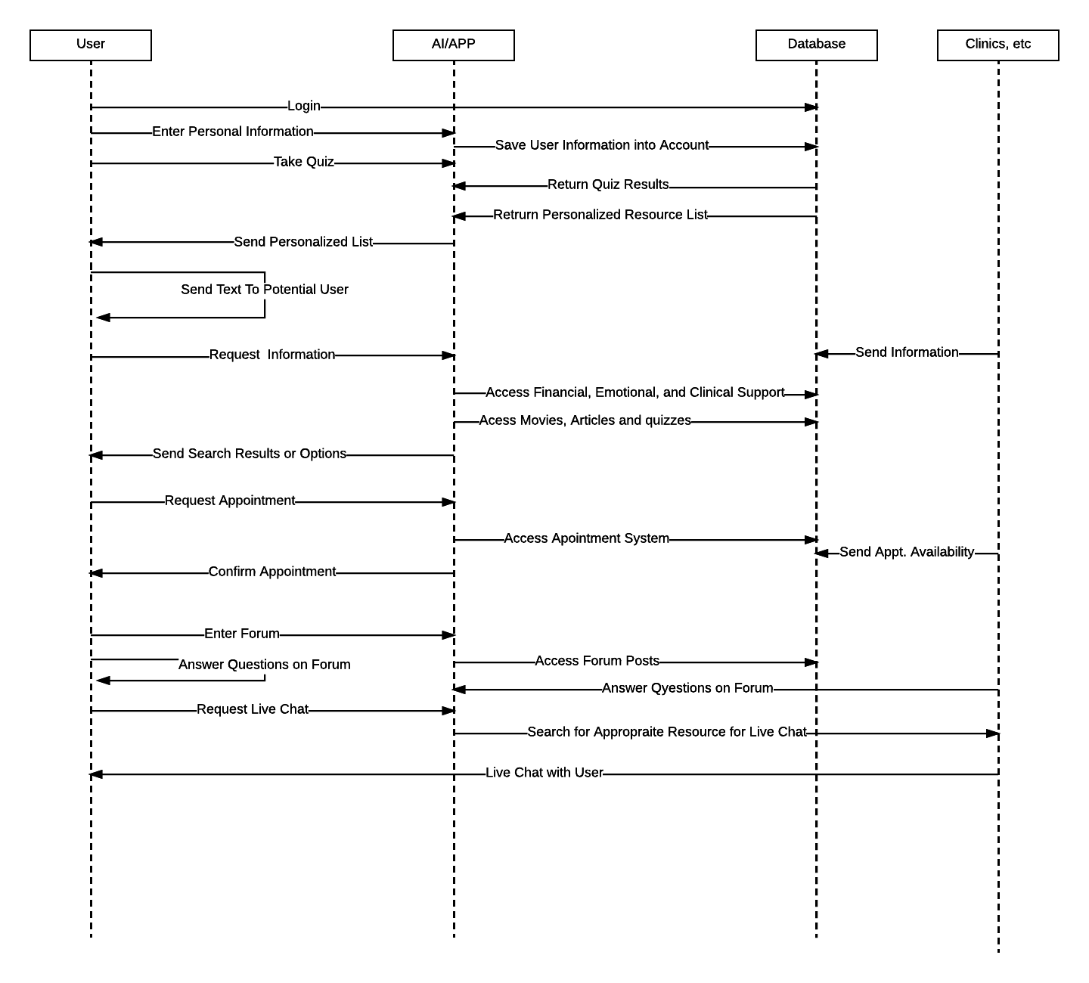
Sequence Diagram
Notes:
The sequence diagram displays the interactions between the user(s), the AI/APP, Database, and the Clinics. The user may use the login page to access their profile information from the database, as well as enter personal information through the AI which will they update into the database. Users will be allowed to take a quiz, which the database will then generate results and a personalized resource list. The AI will then send the personalized list back to the user. The user will can also text a potential user. The user can request information, which the AI will then access based on financial, emotional or clinical need. Clinics will then send information which the AI will then send back based on the need. The user will also then request appointments, which the AI will access through the database based on the information sent by the clinic. The AI will then confirm the appointment for the user. The user can send the forum, which the AI can then Access past posts. The user can also answer forums themselves, or have professinoals from clinics answer. The live chat feature can be accessed through the AI, which will then search for resources from clinincs; once the resource is found then the clinics may access communication with the user directly.

Slide 19
PESTLE Analysis
Cause | Effect
Political
Shift in administration Government focus on healthcare reform | Potential increase/decrease in support of cause Broader network, more agencies and insurance companies
Economic
Increased funding Economic recession | More resources at disposal, increased R&D Cutbacks, decreased funding
Social
Growing healthcare concerns Rise in HIV activism Millennials and Gen Z growing up | Market growth Increased awareness, more conversation around cause Social media circulation, better communication and awareness, better education
Technological
Discovery of cure Enhancement of treatment technology More information technology | Efforts expanded past treatment and prevention to elimination More responsive treatments, less treatments needed Broader reach, larger audience
Legal
Required health insurance (ObamaCare) Legal obligation to disclose status to partners Stricter regulations on pharmaceutical industry | Treatments and programs more accessible to patients Increase in demand for services, i.e. prevention methods and medication Less accessibility of medication and treatments, higher costs
Environmental
More educated workforce Decrease in medication | Increase in technologies Higher demand, increase in costs, thus, increase pricing
Notes:
The ishikawa diagram illustrates the various causes of our main issue that we want our app to solve. Basically we are interested on the issue of HIV/AID and want to find ways to help diagnose those with HIV/AIDS or to help provide support for those who already know that they have HIV/AID or have loved ones that have HIV/AID. One of the main causes is stigma since people do not want to disclose their status since they fear that they will be ostracized by others. Marriage is a factor since those who get married early are more at risk of contracting HIV/AID. Religion is another main cause since many religions such as Catholicism prohibited the use of contraceptives which can increase the risk of contracting HIV/AID or other STDs. Another main factor is the spreading rapid rate of HIV/AID which can be attributed to a large portion of the population having poor access to healthcare or have limited knowledge about HIV/AID. HIV/AID is also more common in urban areas due to the high concentration of people and higher levels of sexual assault. A person’s own sexual choices is another big reason as they may do risky sexual activities such as having multiple partners or unprotected sex which increase their chances of contracting HIV/AID

Slide 20
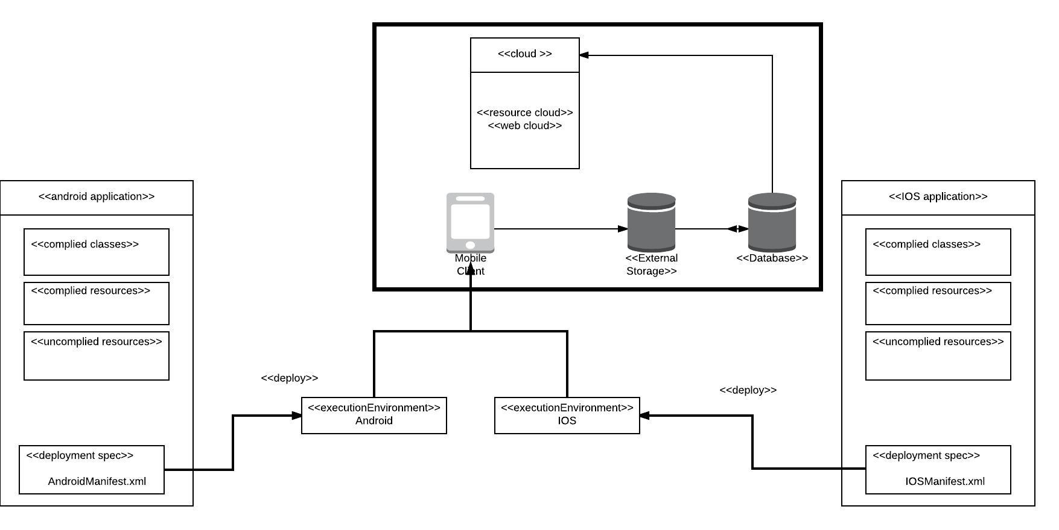
Deployment Diagram

Slide 21
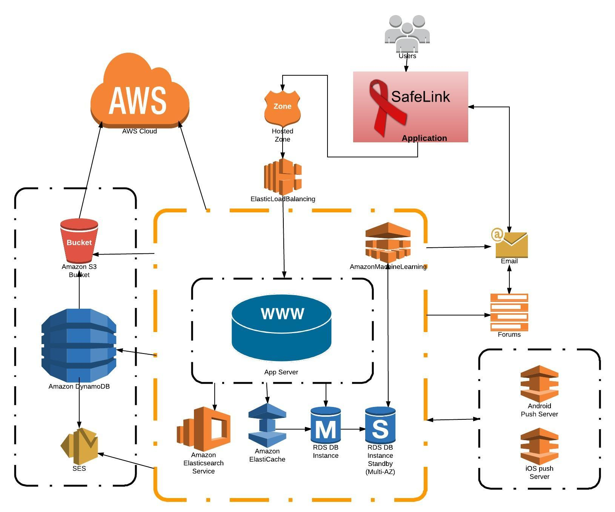
Network Diagram

Slide 22
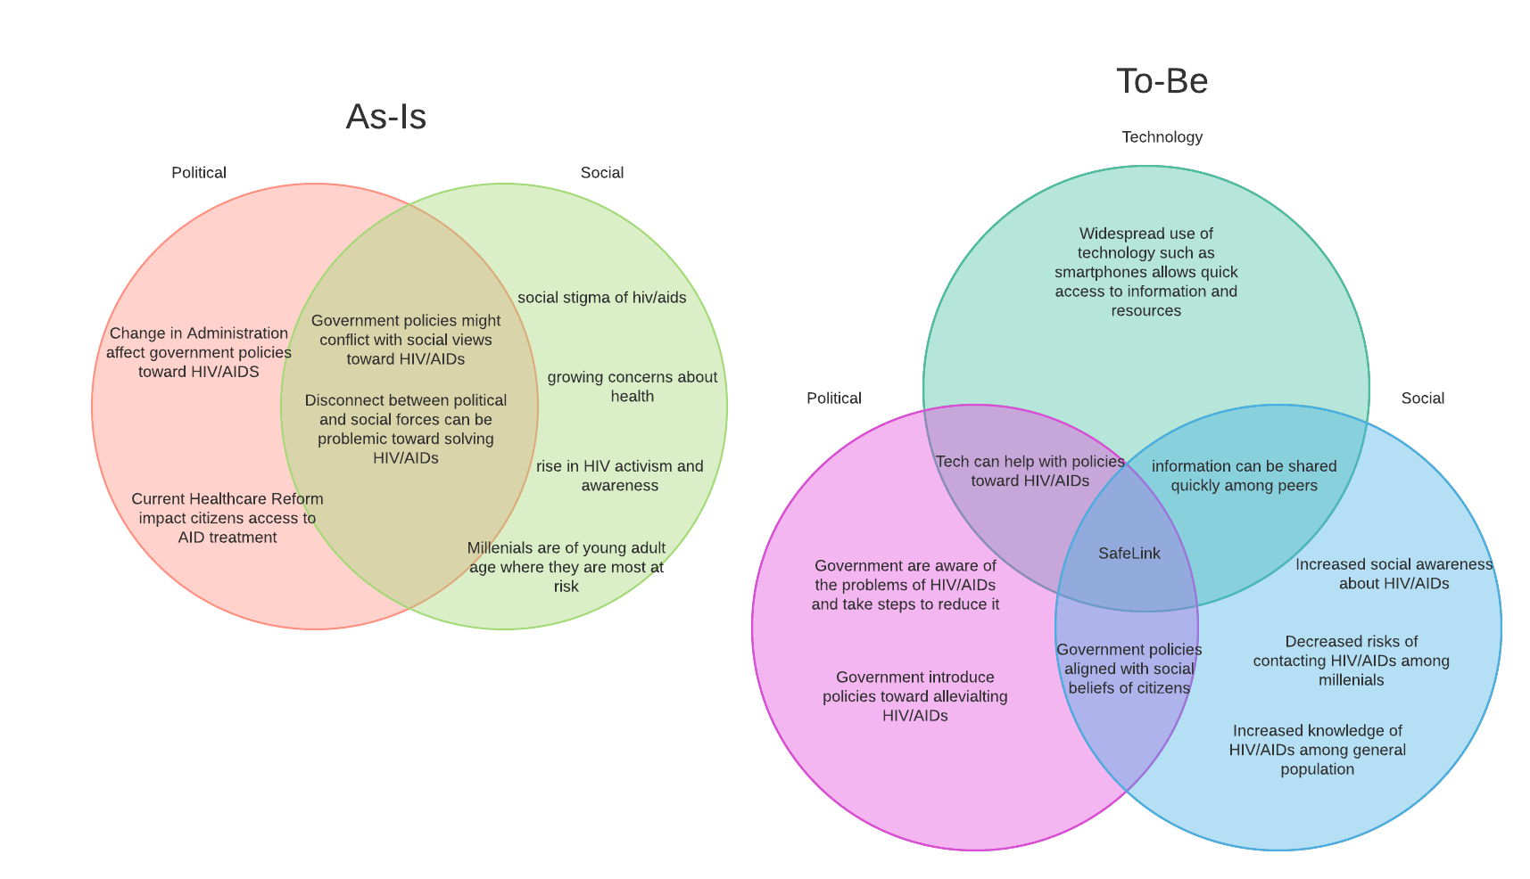
Venn Diagrams
Notes:
The venn diagrams show two scenarios. The first scenario is As-Is and it describes the issue of HIV/AIDs currently in regards to political and social issues. The second scenario is To-Be and it describe how our app, SafeLink will be able to help bridge the gap between the political and social issues surrounding HIV/AIDs.

Slide 23
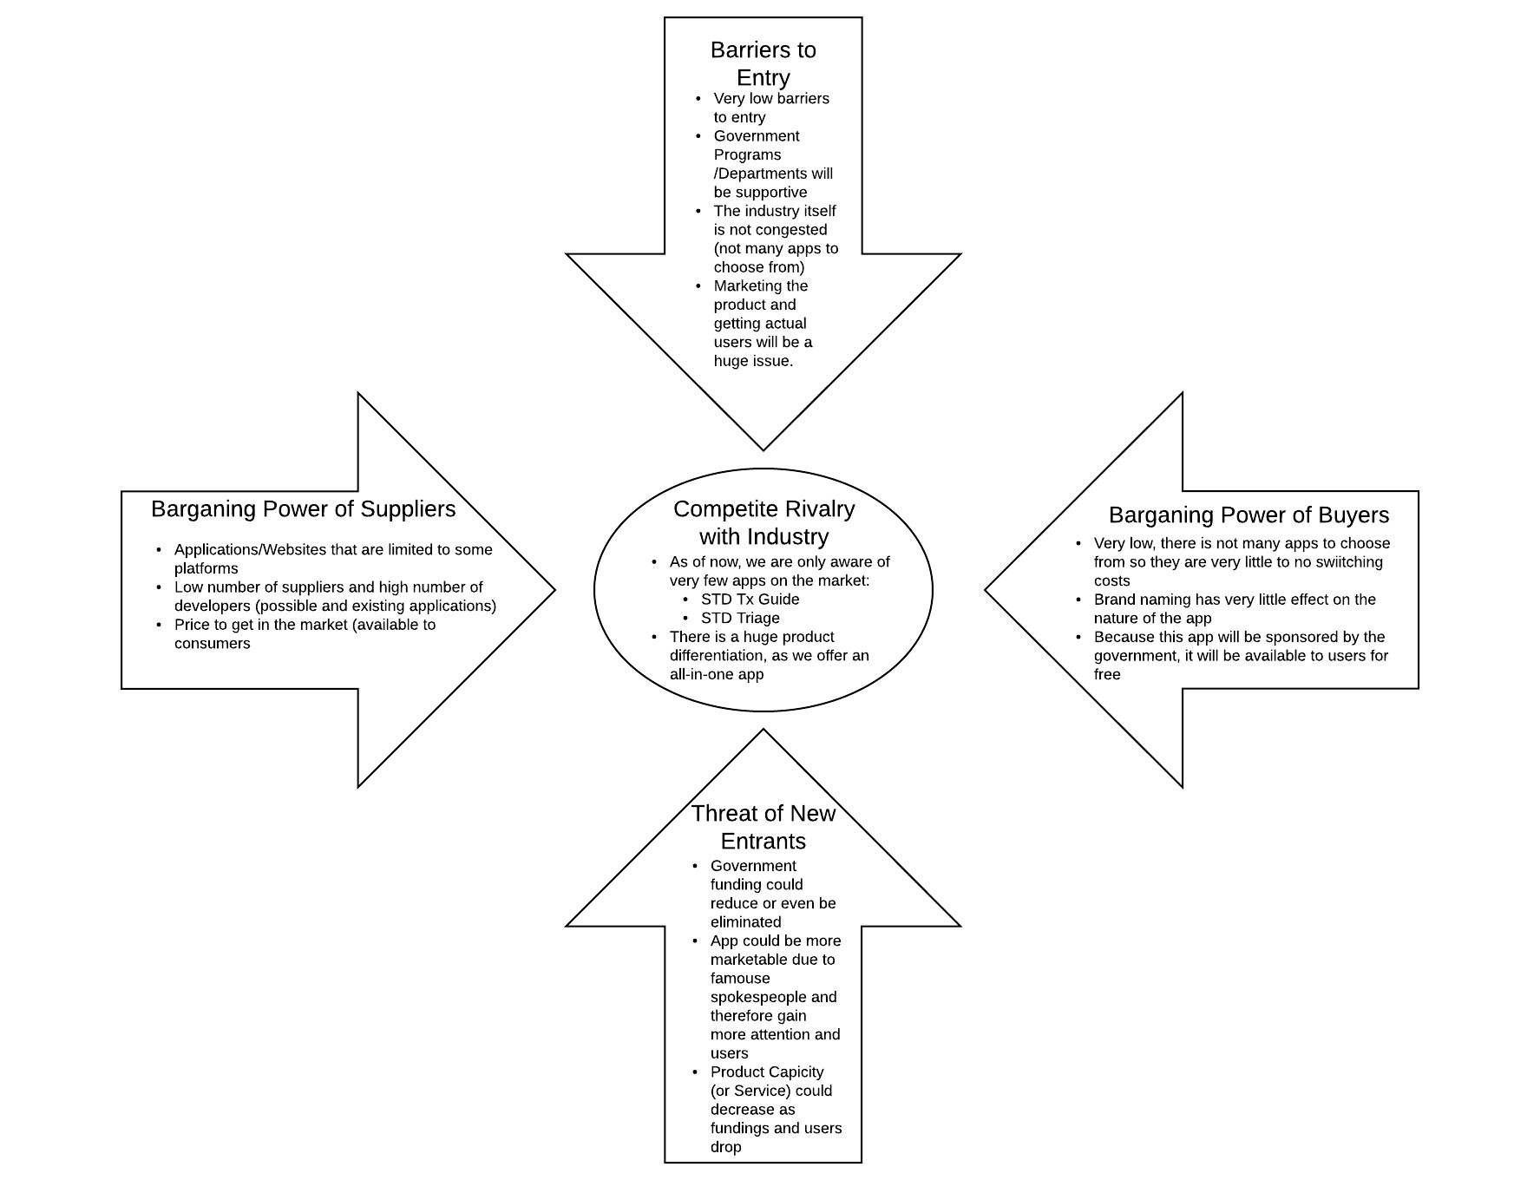
Porter’s Five Forces

Slide 24
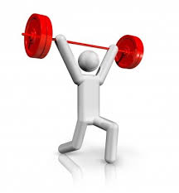
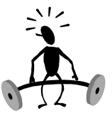
SWOT Diagram
Strength
Mass Funding from social groups
Tackles a huge social problem
Celebrity awareness
Statewide and Government support
Weaknesses
Lack of awareness
Lack of self openness
Difficult to reach target audience
Apps are a saturated market
Ability for people to gather information elsewhere.
Opportunities
Social Media
Current state of technology
Advertising
Medical centers
Educating the masses
Threats
Non-profit aids organizations and social groups
Negativity
Confidentiality
Uneducated
Notes:
For the SWOT Diagram we just brainstormed what would be our strength, weaknesses, opportunities, and threats for the app.With the strength side, we don’t have to really worry about the funding because of the many government programs that are out there, and the when we have celebrities that have AIDS it can attract people to confidently use the app. With the opportunity side it is similar to our strengths because if we used our resources wisely we can make opportunities for ourselves through different channels and we are able to draw people into using the app. Also our weaknesses and threats share similar key point in where we are dealing with AIDS because people have a negative connotation and make people dont want to download the app. Also that the lack of education on AIDS make it a weakness for the app.

Slide 25
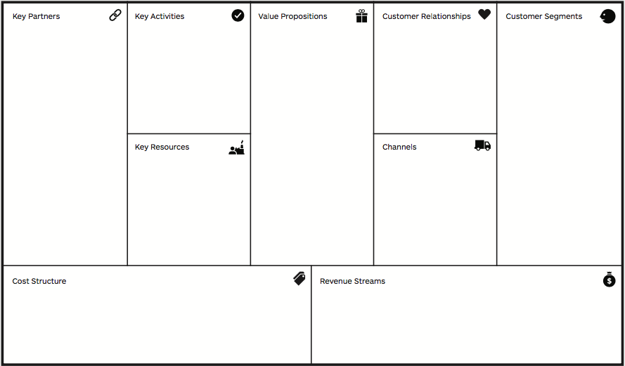
Business Model Canvas
CDC
Government Programs
Hospitals
Clinics
Programmers
Recommenders
Spreading Awareness
Constant update
Customer support
News update
The spreading of awareness of AIDS to the world in order to gain the knowledge of AIDS or helping someone that is a victim of the virus.
Facts of the Day
Youtube Videos
Mini Games
Text messages
Homosexuals
Teens
Adults
Sexual active people
Customer List
Programmers
Investors
Social media
Advertisement
Recommendations
Mobile
Web
Web Servers
Media
Advertisement
Getting users to donate if they want updates through the app and further research of Aids
Freemium
Notes:
For the business model canvas, it is a diagram to show the development of a company or project. Within the diagrams it gives a visual representation of a company’s infrastructure, customer and finances and how to organize the company. The value proposition is the idea of who does your product serve. Customer Segments is composed of the demographic that product is aimed towards. Channels is on how the product is reaching the customer through various different ways. The customer relationship is the part the company’s plan to get a hold of their customer and how to keep them. The revenue stream is how the app is acquire capital to support itself. The key resources is composed of the important assets that the campany has at it disposal. Key Partners are the people that your company is teaming up to make your company work and also expanding. The Activities are the ideas in which the company needs to excutue to make the business model work in order to get the company running. Last the cost structure is the operation cost for the company in the business model.

Slide 26
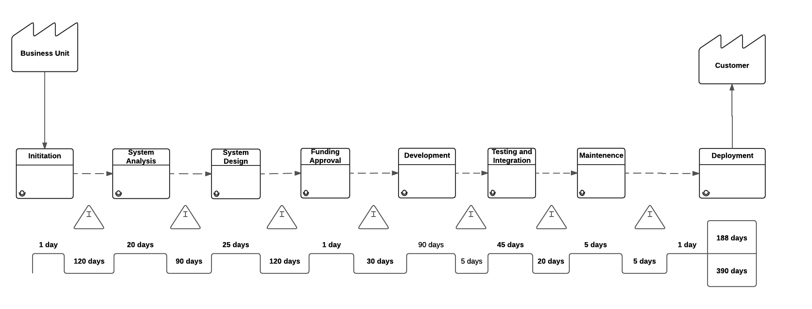
Value Stream Analysis
Notes:
The Value Stream Analysis illustrates and analyzes the steps and processes that is needed to create a product or service and deliver it to the customer. The value stream analysis for Safelink is similar to a typical waterfall development methodology. As it is a software app, raw materials and productions aren’t needed. Instead, it begins with initiation which is where the initial idea is brought up and discusses upon. Then afterward, the system analysis phase take place. During this phase, diagrams such as the BMM, BPMN, Ishikawa, Use Case Diagram, Class Diagrams, and Sequence Diagrams are created to give a general idea of the purpose of the project and what end project we want to deliver to the customer and what impact it would have on preventing HIV/AIDs. Afterward, a design of the overall system takes place including desigining its UI and its features. Afterward, funding will need to be approved in order to have enough finances to cover the project. Development of the app begins and afterward, testing and maintence is done to see if the overall app meets all the business and technical requirements. The app is then ready to be released to the general public.

